Slide 1
Rigid Body Dynamics

Slide 2
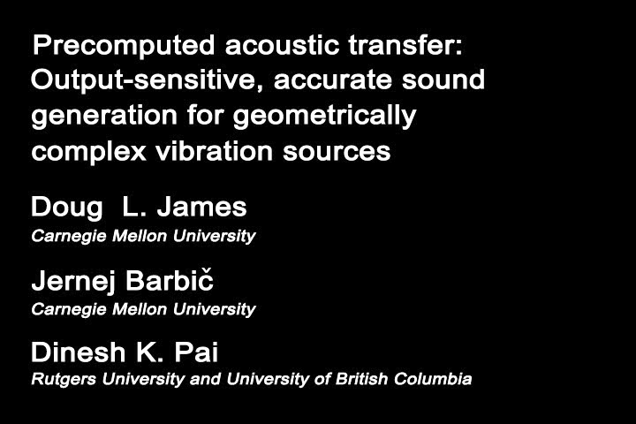
Videos

Slide 3
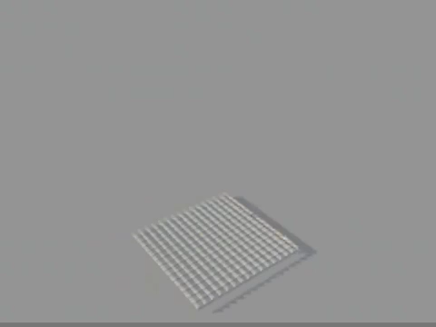

Slide 4
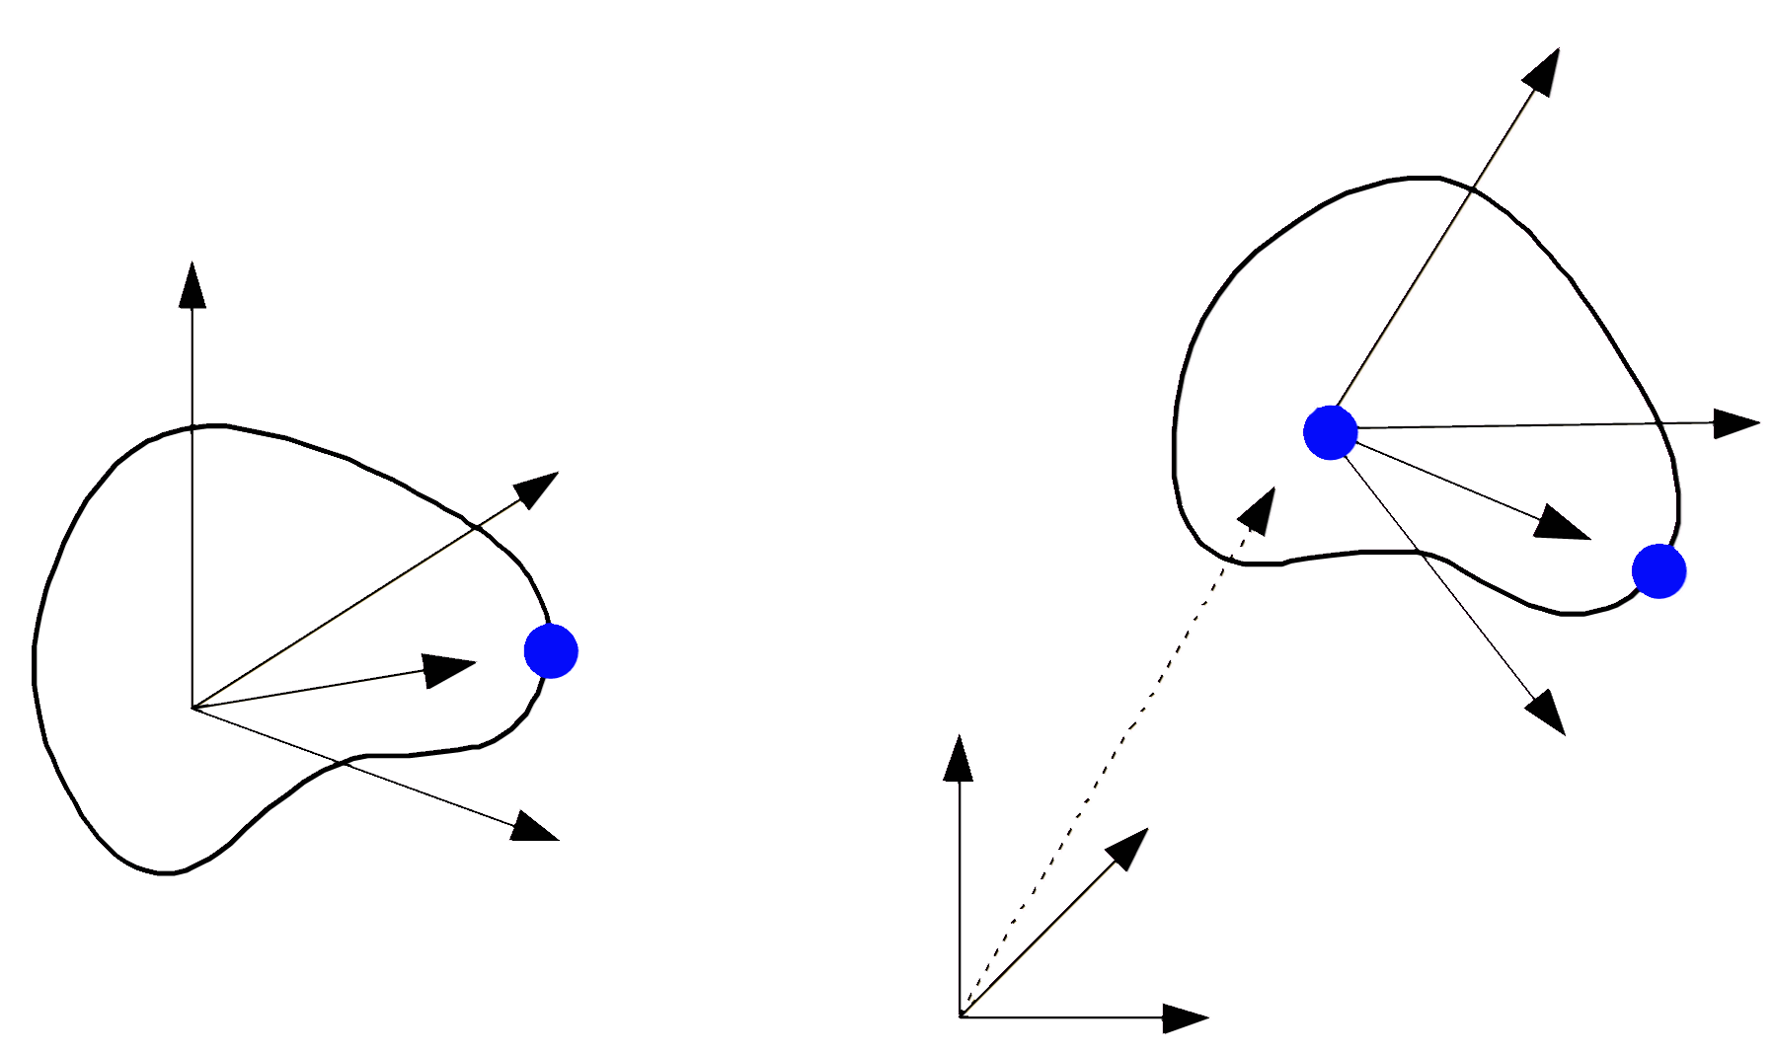
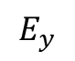
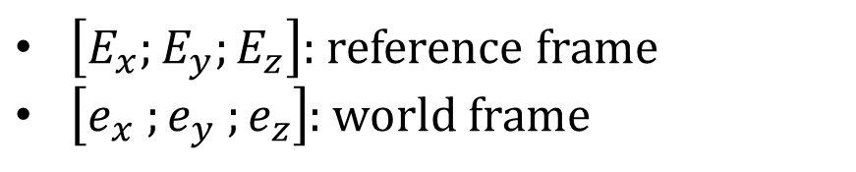
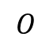
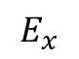
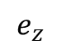
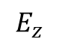
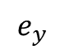
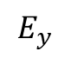
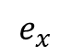
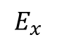
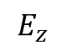
Rigid Body
$\left[E_{x};E_{y};E_{z}\right]$: reference frame
$\left[e_{x} ;e_{y} ;e_{z}\right]$: world frame
$$e_{z}$$
$$E_{z}$$
$$E_{y}$$
$$e_{y}$$
$$E_{z}$$
$$E_{y}$$
$$e_{x}$$
$$E_{x}$$
$$O$$
$$E_{x}$$
Reference Space
World Space

Slide 5

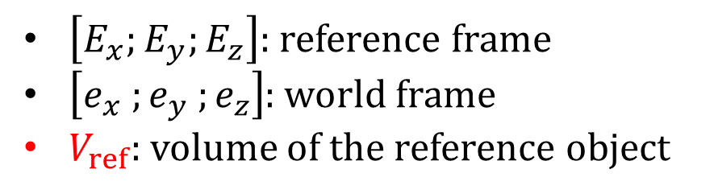
Rigid Body
$\left[E_{x};E_{y};E_{z}\right]$: reference frame
$\left[e_{x} ;e_{y} ;e_{z}\right]$: world frame
$V_{ref}$: volume of the reference object
$$e_{z}$$
$$E_{z}$$
$$V_{ref}$$
$$e_{y}$$
$$E_{y}$$
$$E_{z}$$
$$E_{y}$$
$$e_{x}$$
$$E_{x}$$
$$O$$
$$E_{x}$$
Reference Space
World Space

Slide 6
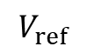
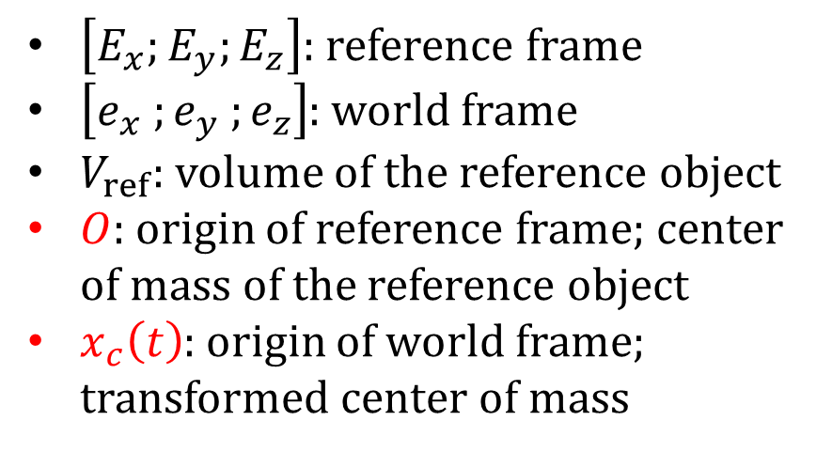
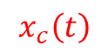

Rigid Body
$\left[E_{x};E_{y};E_{z}\right]$: reference frame
$\left[e_{x} ;e_{y} ;e_{z}\right]$: world frame
$V_{ref}$: volume of the reference object
$O$: origin of reference frame; center of mass of the reference object
$x_{c}\left(t\right)$: origin of world frame; transformed center of mass
$$e_{z}$$
$$E_{z}$$
$$V_{ref}$$
$$x_{c}\left(t\right)$$
$$E_{y}$$
$$e_{y}$$
$$E_{z}$$
$$O$$
$$e_{x}$$
$$E_{y}$$
$$E_{x}$$
$$O$$
$$E_{x}$$
Reference Space
World Space

Slide 7
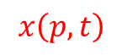
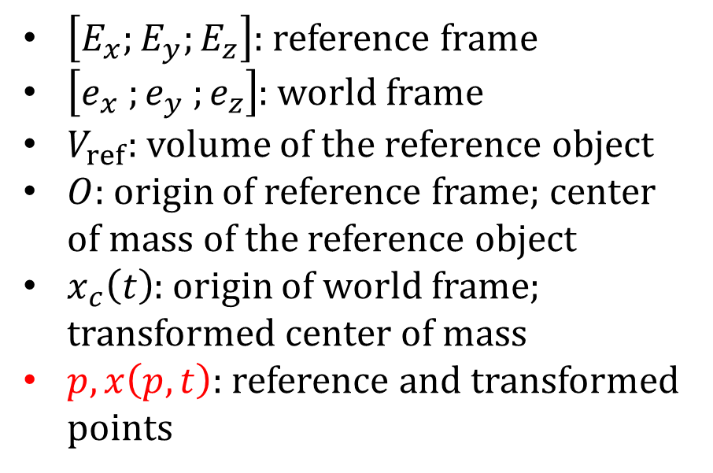
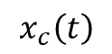
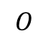
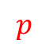
Rigid Body
$\left[E_{x};E_{y};E_{z}\right]$: reference frame
$\left[e_{x} ;e_{y} ;e_{z}\right]$: world frame
$V_{ref}$: volume of the reference object
$O$: origin of reference frame; center of mass of the reference object
$x_{c}\left(t\right)$: origin of world frame; transformed center of mass
$p, x\left(p, t\right)$: reference and transformed points
$$e_{z}$$
$$E_{z}$$
$$V_{ref}$$
$$x_{c}\left(t\right)$$
$$E_{y}$$
$$e_{y}$$
$$p$$
$$x\left(p, t\right)$$
$$E_{z}$$
$$O$$
$$e_{x}$$
$$E_{y}$$
$$E_{x}$$
$$O$$
$$E_{x}$$
Reference Space
World Space

Slide 8
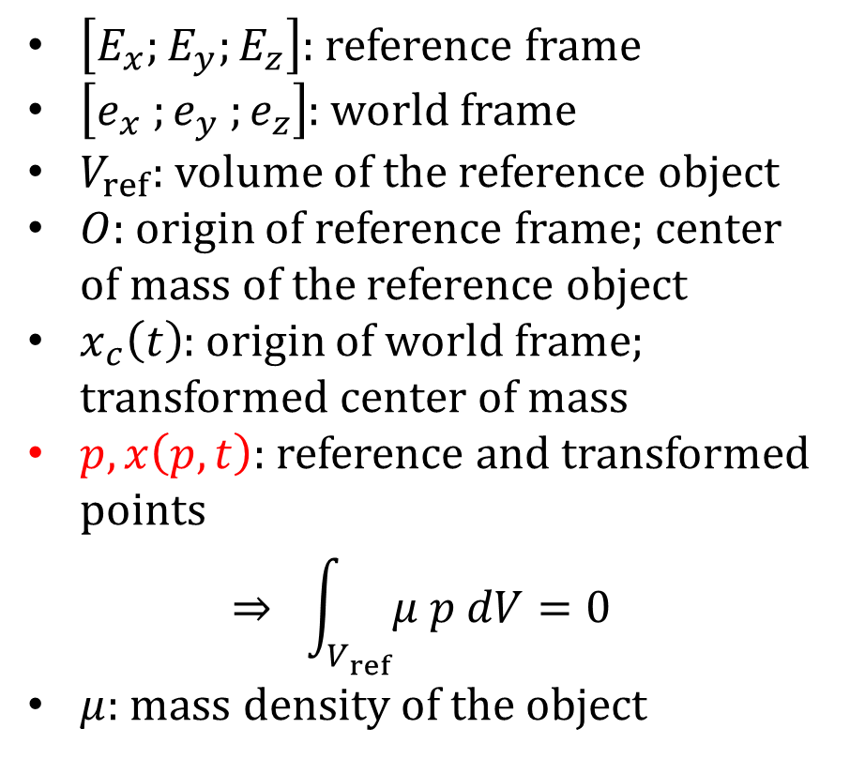
Rigid Body
$\left[E_{x};E_{y};E_{z}\right]$: reference frame
$\left[e_{x} ;e_{y} ;e_{z}\right]$: world frame
$V_{ref}$: volume of the reference object
$O$: origin of reference frame; center of mass of the reference object
$x_{c}\left(t\right)$: origin of world frame; transformed center of mass
$p, x\left(p, t\right)$: reference and transformed points
$$⇒ \int_{V_{ref}}{μ p dV=0}$$
$μ$: mass density of the object
$$e_{z}$$
$$E_{z}$$
$$V_{ref}$$
$$x_{c}\left(t\right)$$
$$E_{y}$$
$$e_{y}$$
$$p$$
$$x\left(p, t\right)$$
$$E_{z}$$
$$O$$
$$e_{x}$$
$$E_{y}$$
$$E_{x}$$
$$O$$
$$E_{x}$$
Reference Space
World Space

Slide 9
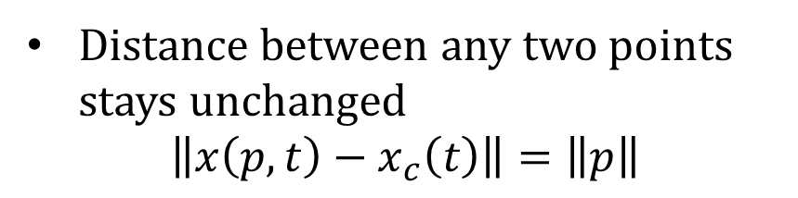
Rigid Body Assumption
Distance between any two points stays unchanged
$$\left\|x\left(p, t\right)−x_{c}\left(t\right)\right\|=\left\|p\right\|$$
$$e_{z}$$
$$E_{z}$$
$$V_{ref}$$
$$x_{c}\left(t\right)$$
$$E_{y}$$
$$e_{y}$$
$$p$$
$$x\left(p, t\right)$$
$$E_{z}$$
$$O$$
$$e_{x}$$
$$E_{y}$$
$$E_{x}$$
$$O$$
$$E_{x}$$
Reference Space
World Space

Slide 10
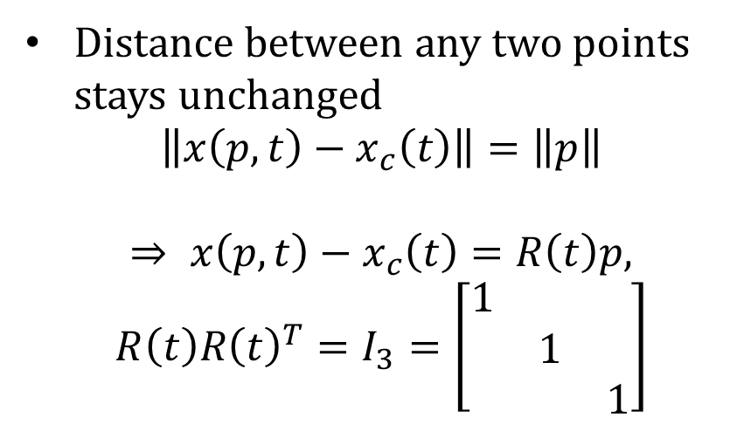
Rigid Body Assumption
Distance between any two points stays unchanged
$$\left\|x\left(p, t\right)−x_{c}\left(t\right)\right\|=\left\|p\right\|$$
$$⇒ x\left(p, t\right)−x_{c}\left(t\right)=R\left(t\right)p,$$
$$R\left(t\right)R{\left(t\right)}^{T}=I_{3}=\left[\begin{matrix}1 & & \\ & 1 & \\ & & 1\end{matrix}\right]$$
$$e_{z}$$
$$E_{z}$$
$$V_{ref}$$
$$x_{c}\left(t\right)$$
$$E_{y}$$
$$e_{y}$$
$$p$$
$$x\left(p, t\right)$$
$$E_{z}$$
$$O$$
$$e_{x}$$
$$E_{y}$$
$$E_{x}$$
$$O$$
$$E_{x}$$
Reference Space
World Space

Slide 11
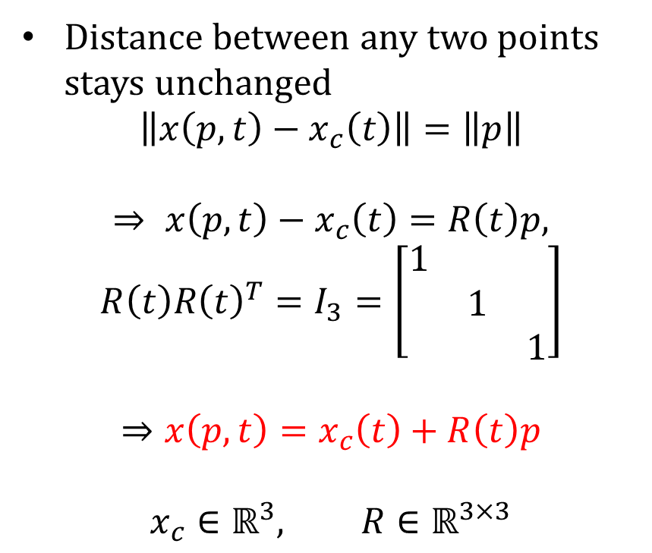
Rigid Body Assumption
Distance between any two points stays unchanged
$$\left\|x\left(p, t\right)−x_{c}\left(t\right)\right\|=\left\|p\right\|$$
$$⇒ x\left(p, t\right)−x_{c}\left(t\right)=R\left(t\right)p,$$
$$R\left(t\right)R{\left(t\right)}^{T}=I_{3}=\left[\begin{matrix}1 & & \\ & 1 & \\ & & 1\end{matrix}\right]$$
$$⇒x\left(p, t\right)=x_{c}\left(t\right)+R\left(t\right)p$$
$$x_{c}∈ℝ^{3}, R∈ℝ^{3×3}$$
$$e_{z}$$
$$E_{z}$$
$$V_{ref}$$
$$x_{c}\left(t\right)$$
$$E_{y}$$
$$e_{y}$$
$$p$$
$$x\left(p, t\right)$$
$$E_{z}$$
$$O$$
$$e_{x}$$
$$E_{y}$$
$$E_{x}$$
$$O$$
$$E_{x}$$
Reference Space
World Space

Slide 12
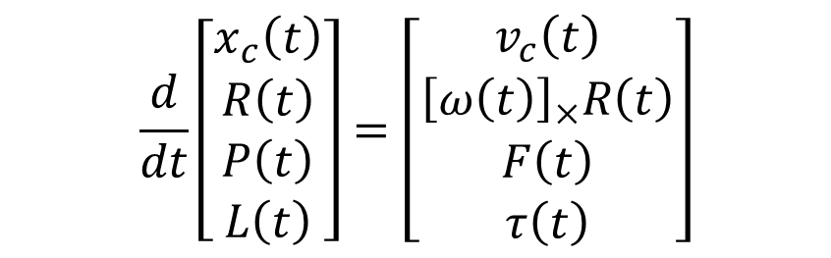
Rigid Body Equation of Motion
$$e_{z}$$
$$E_{z}$$
$$V_{ref}$$
$$x_{c}\left(t\right)$$
$$E_{y}$$
$$e_{y}$$
$$\frac{d}{dt}\left[\begin{matrix}\begin{matrix}x_{c}\left(t\right) \\ R\left(t\right)\end{matrix} \\ \begin{matrix}P\left(t\right) \\ L\left(t\right)\end{matrix}\end{matrix}\right]=\left[\begin{matrix}\begin{matrix}v_{c}\left(t\right) \\ {\left[ω\left(t\right)\right]}_{×}R\left(t\right)\end{matrix} \\ \begin{matrix}F\left(t\right) \\ τ\left(t\right)\end{matrix}\end{matrix}\right]$$
$$p$$
$$x\left(p, t\right)$$
$$E_{z}$$
$$O$$
$$e_{x}$$
$$E_{y}$$
$$E_{x}$$
$$O$$
$$E_{x}$$
Reference Space
World Space

Slide 13
Velocity of a Point
$$e_{z}$$
$$x\left(p, t\right)=x_{c}\left(t\right)+R\left(t\right)p$$
$$E_{z}$$
$$V_{ref}$$
$$x_{c}\left(t\right)$$
$$E_{y}$$
$$e_{y}$$
$$p$$
$$x\left(p, t\right)$$
$$E_{z}$$
$$O$$
$$e_{x}$$
$$E_{y}$$
$$E_{x}$$
$$O$$
$$E_{x}$$
Reference Space
World Space

Slide 14
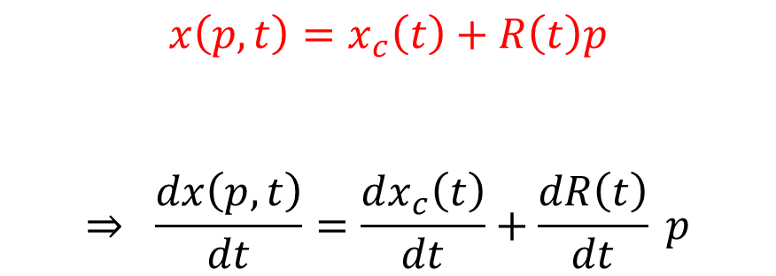
Velocity of a Point
$$e_{z}$$
$$x\left(p, t\right)=x_{c}\left(t\right)+R\left(t\right)p$$
$$⇒ \frac{dx\left(p, t\right)}{dt}=\frac{dx_{c}\left(t\right)}{dt}+\frac{dR\left(t\right)}{dt} p$$
$$E_{z}$$
$$V_{ref}$$
$$x_{c}\left(t\right)$$
$$E_{y}$$
$$e_{y}$$
$$p$$
$$x\left(p, t\right)$$
$$E_{z}$$
$$O$$
$$e_{x}$$
$$E_{y}$$
$$E_{x}$$
$$O$$
$$E_{x}$$
Reference Space
World Space

Slide 15
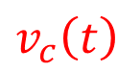
Velocity of a Point
$$e_{z}$$
$$x\left(p, t\right)=x_{c}\left(t\right)+R\left(t\right)p$$
$$⇒ \frac{dx\left(p, t\right)}{dt}=\frac{dx_{c}\left(t\right)}{dt}+\frac{dR\left(t\right)}{dt} p$$
$$E_{z}$$
$$V_{ref}$$
$$x_{c}\left(t\right)$$
$$E_{y}$$
$$e_{y}$$
$$p$$
$$x\left(p, t\right)$$
$$E_{z}$$
$$O$$
$$e_{x}$$
$$E_{y}$$
$$E_{x}$$
$$O$$
$$E_{x}$$
$$v_{c}\left(t\right)$$
World Space
center of mass velocity
Reference Space

Slide 16
Velocity of a Point
$$e_{z}$$
$$x\left(p, t\right)=x_{c}\left(t\right)+R\left(t\right)p$$
$$⇒ \frac{dx\left(p, t\right)}{dt}=\frac{dx_{c}\left(t\right)}{dt}+\frac{dR\left(t\right)}{dt} p$$
$$E_{z}$$
?
$$V_{ref}$$
$$x_{c}\left(t\right)$$
$$E_{y}$$
$$e_{y}$$
$$p$$
$$x\left(p, t\right)$$
$$E_{z}$$
$$O$$
$$e_{x}$$
$$E_{y}$$
$$E_{x}$$
$$O$$
$$E_{x}$$
$$v_{c}\left(t\right)$$
World Space
center of mass velocity
Reference Space

Slide 17
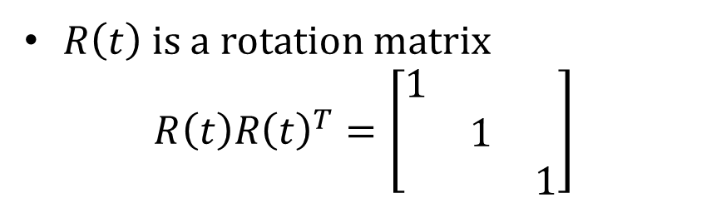
Angular Velocity
$R\left(t\right)$ is a rotation matrix
$$R\left(t\right)R{\left(t\right)}^{T}=\left[\begin{matrix}1 & & \\ & 1 & \\ & & 1\end{matrix}\right]$$

Slide 18
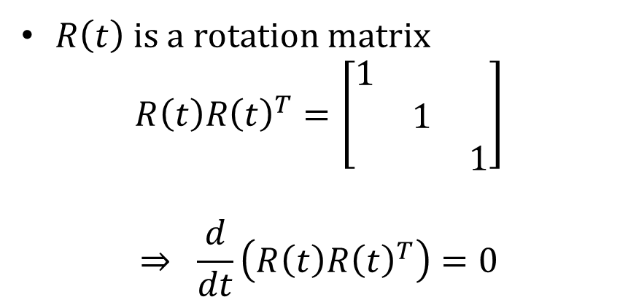
Angular Velocity
$R\left(t\right)$ is a rotation matrix
$$R\left(t\right)R{\left(t\right)}^{T}=\left[\begin{matrix}1 & & \\ & 1 & \\ & & 1\end{matrix}\right]$$
$$⇒ \frac{d}{dt}\left(R\left(t\right)R{\left(t\right)}^{T}\right)=0$$

Slide 19
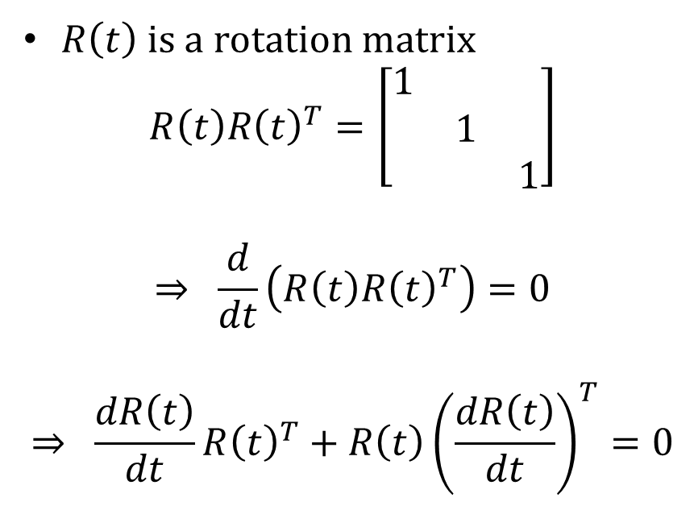
Angular Velocity
$R\left(t\right)$ is a rotation matrix
$$R\left(t\right)R{\left(t\right)}^{T}=\left[\begin{matrix}1 & & \\ & 1 & \\ & & 1\end{matrix}\right]$$
$$⇒ \frac{d}{dt}\left(R\left(t\right)R{\left(t\right)}^{T}\right)=0$$
$$⇒ \frac{dR\left(t\right)}{dt}R{\left(t\right)}^{T}+R\left(t\right){\left(\frac{dR\left(t\right)}{dt}\right)}^{T}=0$$

Slide 20
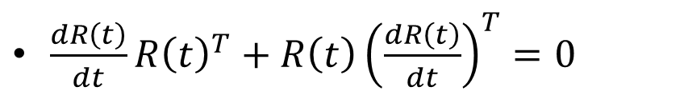
Angular Velocity
$R\left(t\right)$ is a rotation matrix
$$R\left(t\right)R{\left(t\right)}^{T}=\left[\begin{matrix}1 & & \\ & 1 & \\ & & 1\end{matrix}\right]$$
$$⇒ \frac{d}{dt}\left(R\left(t\right)R{\left(t\right)}^{T}\right)=0$$
$$⇒ \frac{dR\left(t\right)}{dt}R{\left(t\right)}^{T}+R\left(t\right){\left(\frac{dR\left(t\right)}{dt}\right)}^{T}=0$$
$\frac{dR\left(t\right)}{dt}R{\left(t\right)}^{T}+R\left(t\right){\left(\frac{dR\left(t\right)}{dt}\right)}^{T}=0$

Slide 21
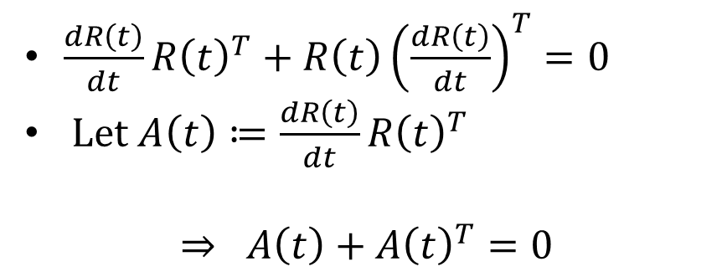
Angular Velocity
$R\left(t\right)$ is a rotation matrix
$$R\left(t\right)R{\left(t\right)}^{T}=\left[\begin{matrix}1 & & \\ & 1 & \\ & & 1\end{matrix}\right]$$
$$⇒ \frac{d}{dt}\left(R\left(t\right)R{\left(t\right)}^{T}\right)=0$$
$$⇒ \frac{dR\left(t\right)}{dt}R{\left(t\right)}^{T}+R\left(t\right){\left(\frac{dR\left(t\right)}{dt}\right)}^{T}=0$$
$\frac{dR\left(t\right)}{dt}R{\left(t\right)}^{T}+R\left(t\right){\left(\frac{dR\left(t\right)}{dt}\right)}^{T}=0$
Let $A\left(t\right)≔\frac{dR\left(t\right)}{dt}R{\left(t\right)}^{T}$
$$⇒ A\left(t\right)+A{\left(t\right)}^{T}=0$$

Slide 22
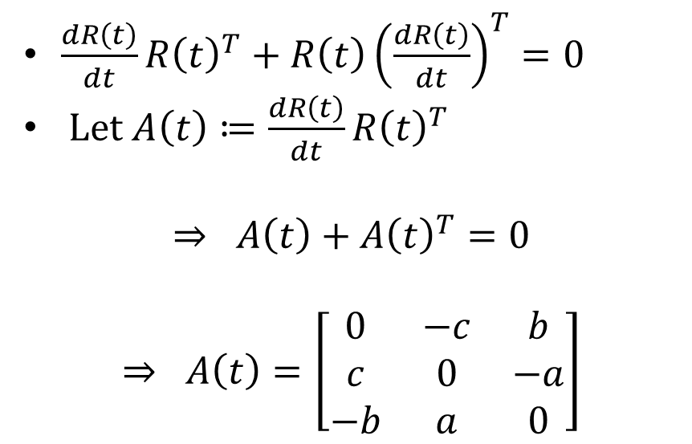
Angular Velocity
$R\left(t\right)$ is a rotation matrix
$$R\left(t\right)R{\left(t\right)}^{T}=\left[\begin{matrix}1 & & \\ & 1 & \\ & & 1\end{matrix}\right]$$
$$⇒ \frac{d}{dt}\left(R\left(t\right)R{\left(t\right)}^{T}\right)=0$$
$$⇒ \frac{dR\left(t\right)}{dt}R{\left(t\right)}^{T}+R\left(t\right){\left(\frac{dR\left(t\right)}{dt}\right)}^{T}=0$$
$\frac{dR\left(t\right)}{dt}R{\left(t\right)}^{T}+R\left(t\right){\left(\frac{dR\left(t\right)}{dt}\right)}^{T}=0$
Let $A\left(t\right)≔\frac{dR\left(t\right)}{dt}R{\left(t\right)}^{T}$
$$⇒ A\left(t\right)+A{\left(t\right)}^{T}=0$$
$$⇒ A\left(t\right)=\left[\begin{matrix}0 & −c & b \\ c & 0 & −a \\ −b & a & 0\end{matrix}\right]$$

Slide 23

Cross Product Matrix
For a vector $v=\left[\begin{matrix}v_{x} \\ v_{y} \\ v_{z}\end{matrix}\right]$, denote ${\left[v\right]}_{×}=\left[\begin{matrix}0 & −v_{z} & v_{y} \\ v_{z} & 0 & −v_{x} \\ −v_{y} & v_{x} & 0\end{matrix}\right]$

Slide 24
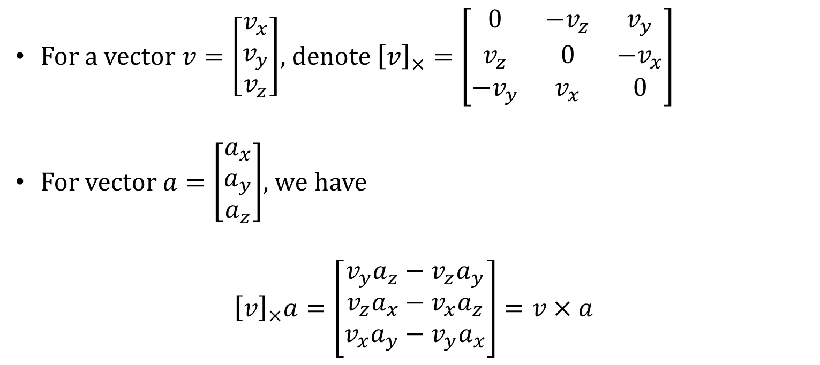
Cross Product Matrix
For a vector $v=\left[\begin{matrix}v_{x} \\ v_{y} \\ v_{z}\end{matrix}\right]$, denote ${\left[v\right]}_{×}=\left[\begin{matrix}0 & −v_{z} & v_{y} \\ v_{z} & 0 & −v_{x} \\ −v_{y} & v_{x} & 0\end{matrix}\right]$
For vector $a=\left[\begin{matrix}a_{x} \\ a_{y} \\ a_{z}\end{matrix}\right]$, we have
$${\left[v\right]}_{×}a=\left[\begin{matrix}v_{y}a_{z}−v_{z}a_{y} \\ v_{z}a_{x}−v_{x}a_{z} \\ v_{x}a_{y}−v_{y}a_{x}\end{matrix}\right]=v×a$$

Slide 25
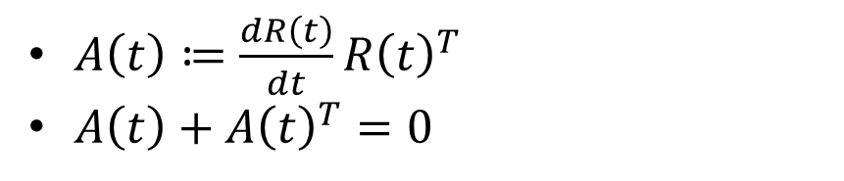
Angular Velocity
$A\left(t\right)≔\frac{dR\left(t\right)}{dt}R{\left(t\right)}^{T}$
$A\left(t\right)+A{\left(t\right)}^{T}=0$

Slide 26
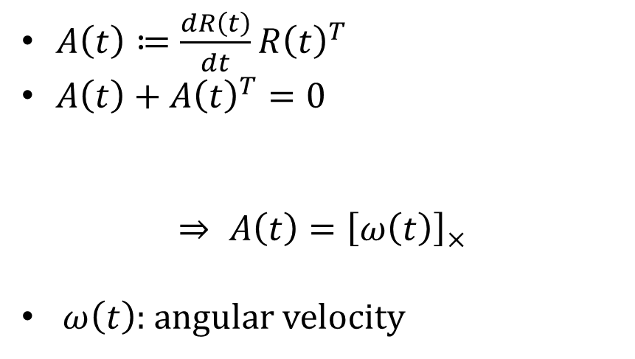
Angular Velocity
$A\left(t\right)≔\frac{dR\left(t\right)}{dt}R{\left(t\right)}^{T}$
$A\left(t\right)+A{\left(t\right)}^{T}=0$
$$⇒ A\left(t\right)={\left[ω\left(t\right)\right]}_{×}$$
$ω\left(t\right)$: angular velocity

Slide 27
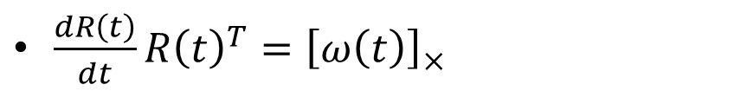
Angular Velocity
$A\left(t\right)≔\frac{dR\left(t\right)}{dt}R{\left(t\right)}^{T}$
$A\left(t\right)+A{\left(t\right)}^{T}=0$
$$⇒ A\left(t\right)={\left[ω\left(t\right)\right]}_{×}$$
$ω\left(t\right)$: angular velocity
$\frac{dR\left(t\right)}{dt}R{\left(t\right)}^{T}={\left[ω\left(t\right)\right]}_{×}$

Slide 28
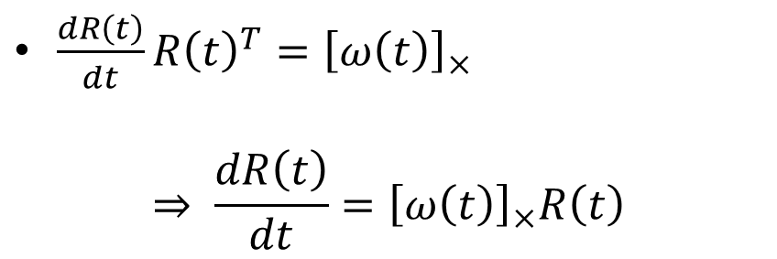
Angular Velocity
$A\left(t\right)≔\frac{dR\left(t\right)}{dt}R{\left(t\right)}^{T}$
$A\left(t\right)+A{\left(t\right)}^{T}=0$
$$⇒ A\left(t\right)={\left[ω\left(t\right)\right]}_{×}$$
$ω\left(t\right)$: angular velocity
$\frac{dR\left(t\right)}{dt}R{\left(t\right)}^{T}={\left[ω\left(t\right)\right]}_{×}$
$$⇒ \frac{dR\left(t\right)}{dt}={\left[ω\left(t\right)\right]}_{×}R\left(t\right)$$

Slide 29
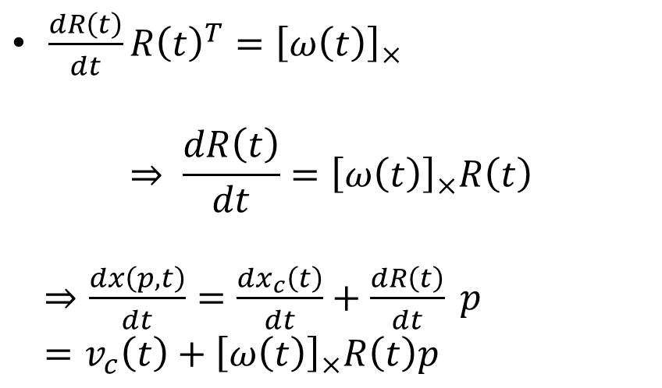
Angular Velocity
$A\left(t\right)≔\frac{dR\left(t\right)}{dt}R{\left(t\right)}^{T}$
$A\left(t\right)+A{\left(t\right)}^{T}=0$
$$⇒ A\left(t\right)={\left[ω\left(t\right)\right]}_{×}$$
$ω\left(t\right)$: angular velocity
$\frac{dR\left(t\right)}{dt}R{\left(t\right)}^{T}={\left[ω\left(t\right)\right]}_{×}$
$$⇒ \frac{dR\left(t\right)}{dt}={\left[ω\left(t\right)\right]}_{×}R\left(t\right)$$
$⇒\frac{dx\left(p, t\right)}{dt}=\frac{dx_{c}\left(t\right)}{dt}+\frac{dR\left(t\right)}{dt} p$
$=v_{c}\left(t\right)+{\left[ω\left(t\right)\right]}_{×}R\left(t\right)p$

Slide 30
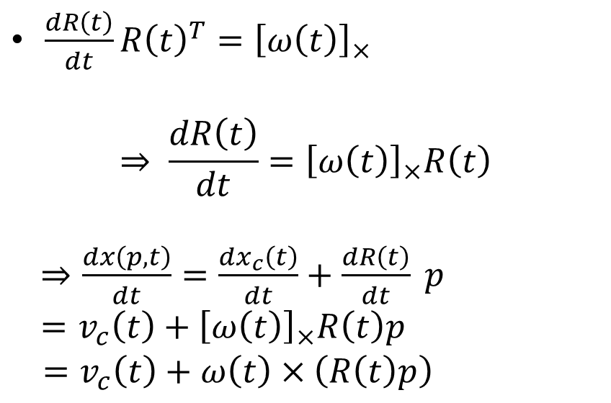
Angular Velocity
$A\left(t\right)≔\frac{dR\left(t\right)}{dt}R{\left(t\right)}^{T}$
$A\left(t\right)+A{\left(t\right)}^{T}=0$
$$⇒ A\left(t\right)={\left[ω\left(t\right)\right]}_{×}$$
$ω\left(t\right)$: angular velocity
$\frac{dR\left(t\right)}{dt}R{\left(t\right)}^{T}={\left[ω\left(t\right)\right]}_{×}$
$$⇒ \frac{dR\left(t\right)}{dt}={\left[ω\left(t\right)\right]}_{×}R\left(t\right)$$
$⇒\frac{dx\left(p, t\right)}{dt}=\frac{dx_{c}\left(t\right)}{dt}+\frac{dR\left(t\right)}{dt} p$
$=v_{c}\left(t\right)+{\left[ω\left(t\right)\right]}_{×}R\left(t\right)p$
$=v_{c}\left(t\right)+ω\left(t\right)×\left(R\left(t\right)p\right)$

Slide 31
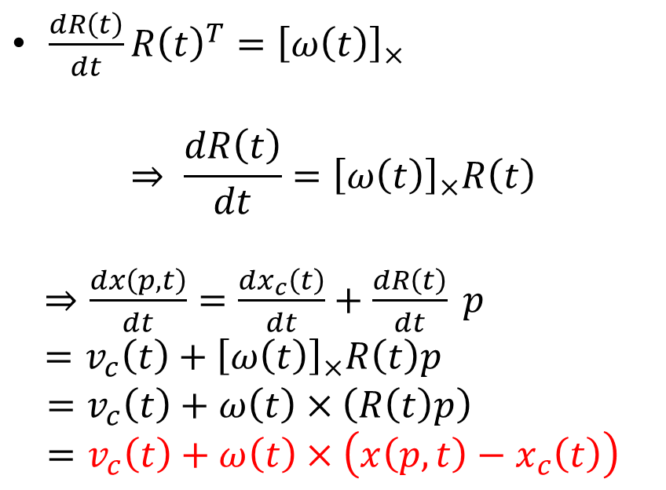
Angular Velocity
$A\left(t\right)≔\frac{dR\left(t\right)}{dt}R{\left(t\right)}^{T}$
$A\left(t\right)+A{\left(t\right)}^{T}=0$
$$⇒ A\left(t\right)={\left[ω\left(t\right)\right]}_{×}$$
$ω\left(t\right)$: angular velocity
$\frac{dR\left(t\right)}{dt}R{\left(t\right)}^{T}={\left[ω\left(t\right)\right]}_{×}$
$$⇒ \frac{dR\left(t\right)}{dt}={\left[ω\left(t\right)\right]}_{×}R\left(t\right)$$
$⇒\frac{dx\left(p, t\right)}{dt}=\frac{dx_{c}\left(t\right)}{dt}+\frac{dR\left(t\right)}{dt} p$
$=v_{c}\left(t\right)+{\left[ω\left(t\right)\right]}_{×}R\left(t\right)p$
$=v_{c}\left(t\right)+ω\left(t\right)×\left(R\left(t\right)p\right)$
$$=v_{c}\left(t\right)+ω\left(t\right)×\left(x\left(p, t\right)−x_{c}\left(t\right)\right)$$

Slide 32
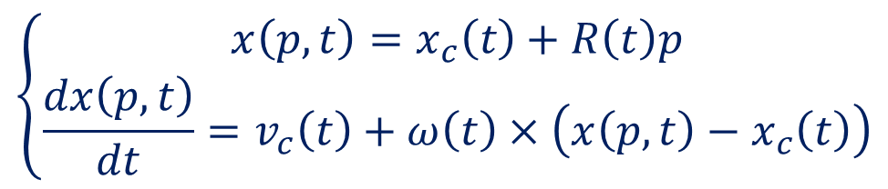
Velocity of a Point
$$e_{z}$$
$$\left\{\begin{aligned}x\left(p, t\right)=x_{c}\left(t\right)+R\left(t\right)p \\ \frac{dx\left(p, t\right)}{dt}=v_{c}\left(t\right)+ω\left(t\right)×\left(x\left(p, t\right)−x_{c}\left(t\right)\right)\end{aligned}\right.$$
$$E_{z}$$
$$V_{ref}$$
$$x_{c}\left(t\right)$$
$$E_{y}$$
$$e_{y}$$
$$p$$
$$x\left(p, t\right)$$
$$E_{z}$$
$$O$$
$$e_{x}$$
$$E_{y}$$
$$E_{x}$$
$$O$$
$$E_{x}$$
Reference Space
World Space

Slide 33
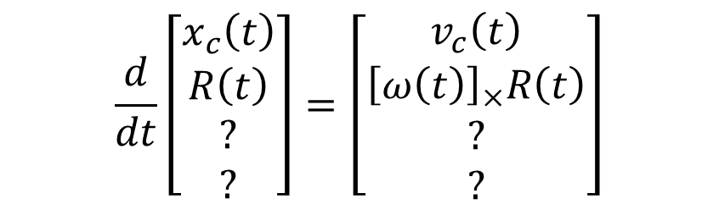
Velocity of a Point
$$e_{z}$$
$$\left\{\begin{aligned}x\left(p, t\right)=x_{c}\left(t\right)+R\left(t\right)p \\ \frac{dx\left(p, t\right)}{dt}=v_{c}\left(t\right)+ω\left(t\right)×\left(x\left(p, t\right)−x_{c}\left(t\right)\right)\end{aligned}\right.$$
$$E_{z}$$
$$V_{ref}$$
$$x_{c}\left(t\right)$$
$$E_{y}$$
$$e_{y}$$
$$p$$
$$x\left(p, t\right)$$
$$E_{z}$$
$$\frac{d}{dt}\left[\begin{matrix}\begin{matrix}x_{c}\left(t\right) \\ R\left(t\right)\end{matrix} \\ \begin{matrix}? \\ ?\end{matrix}\end{matrix}\right]=\left[\begin{matrix}\begin{matrix}v_{c}\left(t\right) \\ {\left[ω\left(t\right)\right]}_{×}R\left(t\right)\end{matrix} \\ \begin{matrix}? \\ ?\end{matrix}\end{matrix}\right]$$
$$O$$
$$e_{x}$$
$$E_{y}$$
$$E_{x}$$
$$O$$
$$E_{x}$$
Reference Space
World Space

Slide 34

Kinetic Energy
$$T=\int_{V_{ref}}{\frac{1}{2}μ{\left\|\frac{dx\left(p, t\right)}{dt}\right\|}^{2}dV}$$

Slide 35
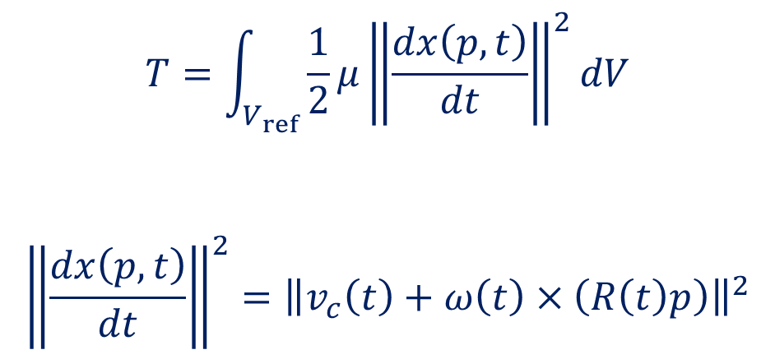
Kinetic Energy
$$T=\int_{V_{ref}}{\frac{1}{2}μ{\left\|\frac{dx\left(p, t\right)}{dt}\right\|}^{2}dV}$$
$${\left\|\frac{dx\left(p, t\right)}{dt}\right\|}^{2}={\left\|v_{c}\left(t\right)+ω\left(t\right)×\left(R\left(t\right)p\right)\right\|}^{2}$$

Slide 36
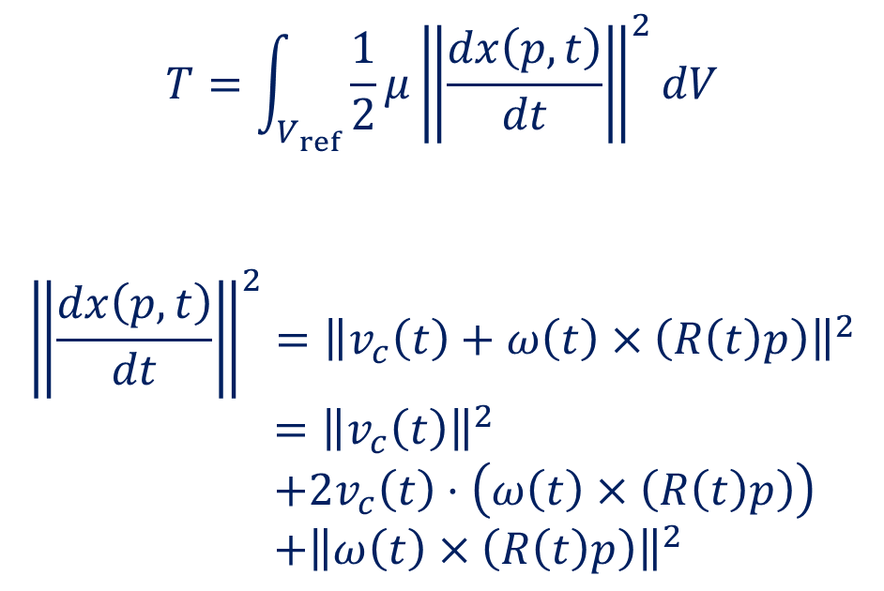
Kinetic Energy
$$T=\int_{V_{ref}}{\frac{1}{2}μ{\left\|\frac{dx\left(p, t\right)}{dt}\right\|}^{2}dV}$$
$${\left\|\frac{dx\left(p, t\right)}{dt}\right\|}^{2}={\left\|v_{c}\left(t\right)+ω\left(t\right)×\left(R\left(t\right)p\right)\right\|}^{2}$$
$={\left\|v_{c}\left(t\right)\right\|}^{2}$
$+2v_{c}\left(t\right)⋅\left(ω\left(t\right)×\left(R\left(t\right)p\right)\right)$
$+{\left\|ω\left(t\right)×\left(R\left(t\right)p\right)\right\|}^{2}$

Slide 37
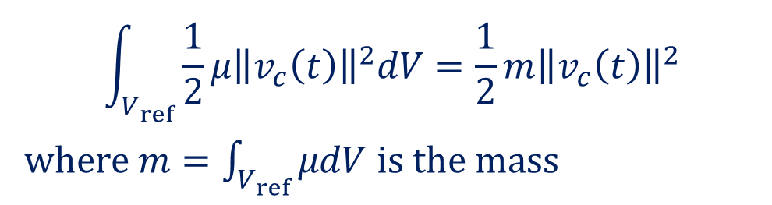
Kinetic Energy
$$\int_{V_{ref}}{\frac{1}{2}μ{\left\|v_{c}\left(t\right)\right\|}^{2}dV}=\frac{1}{2}m{\left\|v_{c}\left(t\right)\right\|}^{2}$$
where $m=\int_{V_{ref}}{μdV}$ is the mass
$$T=\int_{V_{ref}}{\frac{1}{2}μ{\left\|\frac{dx\left(p, t\right)}{dt}\right\|}^{2}dV}$$
$${\left\|\frac{dx\left(p, t\right)}{dt}\right\|}^{2}={\left\|v_{c}\left(t\right)+ω\left(t\right)×\left(R\left(t\right)p\right)\right\|}^{2}$$
$={\left\|v_{c}\left(t\right)\right\|}^{2}$
$+2v_{c}\left(t\right)⋅\left(ω\left(t\right)×\left(R\left(t\right)p\right)\right)$
$+{\left\|ω\left(t\right)×\left(R\left(t\right)p\right)\right\|}^{2}$

Slide 38
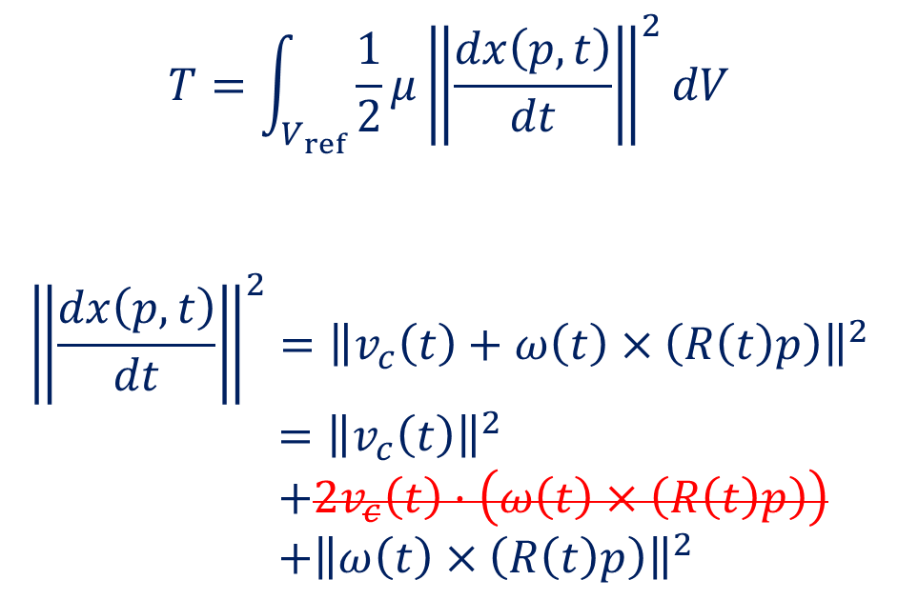

Kinetic Energy
$$\int_{V_{ref}}{\frac{1}{2}μ{\left\|v_{c}\left(t\right)\right\|}^{2}dV}=\frac{1}{2}m{\left\|v_{c}\left(t\right)\right\|}^{2}$$
where $m=\int_{V_{ref}}{μdV}$ is the mass
$$\int_{V_{ref}}{μv_{c}\left(t\right)⋅\left(ω\left(t\right)×\left(R\left(t\right)p\right)\right)dV}$$
$$=μv_{c}{\left(t\right)}^{T}{\left[ω\left(t\right)\right]}_{×}R\left(t\right)\int_{V_{ref}}{μ p dV}$$
$=0$
$$T=\int_{V_{ref}}{\frac{1}{2}μ{\left\|\frac{dx\left(p, t\right)}{dt}\right\|}^{2}dV}$$
$${\left\|\frac{dx\left(p, t\right)}{dt}\right\|}^{2}={\left\|v_{c}\left(t\right)+ω\left(t\right)×\left(R\left(t\right)p\right)\right\|}^{2}$$
$={\left\|v_{c}\left(t\right)\right\|}^{2}$
$+2v_{c}\left(t\right)⋅\left(ω\left(t\right)×\left(R\left(t\right)p\right)\right)$
$+{\left\|ω\left(t\right)×\left(R\left(t\right)p\right)\right\|}^{2}$

Slide 39


Kinetic Energy
$$\int_{V_{ref}}{\frac{1}{2}μ{\left\|v_{c}\left(t\right)\right\|}^{2}dV}=\frac{1}{2}m{\left\|v_{c}\left(t\right)\right\|}^{2}$$
where $m=\int_{V_{ref}}{μdV}$ is the mass
$$\int_{V_{ref}}{μv_{c}\left(t\right)⋅\left(ω\left(t\right)×\left(R\left(t\right)p\right)\right)dV}$$
$$=μv_{c}{\left(t\right)}^{T}{\left[ω\left(t\right)\right]}_{×}R\left(t\right)\int_{V_{ref}}{μ p dV}$$
$=0$
$$T=\int_{V_{ref}}{\frac{1}{2}μ{\left\|\frac{dx\left(p, t\right)}{dt}\right\|}^{2}dV}$$
$${\left\|\frac{dx\left(p, t\right)}{dt}\right\|}^{2}={\left\|v_{c}\left(t\right)+ω\left(t\right)×\left(R\left(t\right)p\right)\right\|}^{2}$$
$={\left\|v_{c}\left(t\right)\right\|}^{2}$
$+2v_{c}\left(t\right)⋅\left(ω\left(t\right)×\left(R\left(t\right)p\right)\right)$
$+{\left\|ω\left(t\right)×\left(R\left(t\right)p\right)\right\|}^{2}$

Slide 40
Kinetic Energy
${\left\|a×b\right\|}^{2}={\left\|a\right\|}^{2}{\left\|b\right\|}^{2}−{\left(a⋅b\right)}^{2}$

Slide 41

Kinetic Energy
${\left\|a×b\right\|}^{2}={\left\|a\right\|}^{2}{\left\|b\right\|}^{2}−{\left(a⋅b\right)}^{2}$
$⇒{\left\|ω\left(t\right)×\left(R\left(t\right)p\right)\right\|}^{2}$
$={\left\|ω\left(t\right)\right\|}^{2}{\left\|R\left(t\right)p\right\|}^{2}−{\left(ω\left(t\right)⋅\left(R\left(t\right)p\right)\right)}^{2}$

Slide 42

Kinetic Energy
${\left\|a×b\right\|}^{2}={\left\|a\right\|}^{2}{\left\|b\right\|}^{2}−{\left(a⋅b\right)}^{2}$
$⇒{\left\|ω\left(t\right)×\left(R\left(t\right)p\right)\right\|}^{2}$
$={\left\|ω\left(t\right)\right\|}^{2}{\left\|R\left(t\right)p\right\|}^{2}−{\left(ω\left(t\right)⋅\left(R\left(t\right)p\right)\right)}^{2}$
$={\left\|ω\left(t\right)\right\|}^{2}{\left\|R\left(t\right)p\right\|}^{2}−{\left(ω{\left(t\right)}^{T}R\left(t\right)p\right)}^{2}$

Slide 43

Kinetic Energy
${\left\|a×b\right\|}^{2}={\left\|a\right\|}^{2}{\left\|b\right\|}^{2}−{\left(a⋅b\right)}^{2}$
$⇒{\left\|ω\left(t\right)×\left(R\left(t\right)p\right)\right\|}^{2}$
$={\left\|ω\left(t\right)\right\|}^{2}{\left\|R\left(t\right)p\right\|}^{2}−{\left(ω\left(t\right)⋅\left(R\left(t\right)p\right)\right)}^{2}$
$={\left\|ω\left(t\right)\right\|}^{2}{\left\|R\left(t\right)p\right\|}^{2}−{\left(ω{\left(t\right)}^{T}R\left(t\right)p\right)}^{2}$
$=ω{\left(t\right)}^{T}\left({\left\|R\left(t\right)p\right\|}^{2}\left[\begin{matrix}1 & & \\ & 1 & \\ & & 1\end{matrix}\right]−R\left(t\right)pp^{T}R{\left(t\right)}^{T}\right)ω\left(t\right)$

Slide 44

Kinetic Energy
Define the Inertia Tensor:
$$I\left(t\right)=\int_{V_{ref}}{μ\left({\left\|R\left(t\right)p\right\|}^{2}\left[\begin{matrix}1 & & \\ & 1 & \\ & & 1\end{matrix}\right]−R\left(t\right)pp^{T}R{\left(t\right)}^{T}\right)dV}$$

Slide 45

Kinetic Energy
Define the Inertia Tensor:
$$I\left(t\right)=\int_{V_{ref}}{μ\left({\left\|R\left(t\right)p\right\|}^{2}\left[\begin{matrix}1 & & \\ & 1 & \\ & & 1\end{matrix}\right]−R\left(t\right)pp^{T}R{\left(t\right)}^{T}\right)dV}$$
$$⇒\int_{V_{ref}}{\frac{1}{2}μ{\left\|ω\left(t\right)×\left(R\left(t\right)p\right)\right\|}^{2}dV}=\frac{1}{2}ω{\left(t\right)}^{T}I\left(t\right)ω\left(t\right)$$

Slide 46

Kinetic Energy
Define the Inertia Tensor:
$$I\left(t\right)=\int_{V_{ref}}{μ\left({\left\|R\left(t\right)p\right\|}^{2}\left[\begin{matrix}1 & & \\ & 1 & \\ & & 1\end{matrix}\right]−R\left(t\right)pp^{T}R{\left(t\right)}^{T}\right)dV}$$
$$⇒\int_{V_{ref}}{\frac{1}{2}μ{\left\|ω\left(t\right)×\left(R\left(t\right)p\right)\right\|}^{2}dV}=\frac{1}{2}ω{\left(t\right)}^{T}I\left(t\right)ω\left(t\right)$$
$$⇒T=\frac{1}{2}m{\left\|v_{c}\left(t\right)\right\|}^{2}+\frac{1}{2}ω{\left(t\right)}^{T}I\left(t\right)ω\left(t\right)$$

Slide 47

Momentum
Linear Momentum
$$P\left(t\right)≔mv_{c}\left(t\right)$$

Slide 48

Momentum
Linear Momentum
$$P\left(t\right)≔mv_{c}\left(t\right)$$
Conservation law:
$$dP=F\left(t\right)dt$$
$$⇒\frac{dP\left(t\right)}{dt}=F\left(t\right)$$

Slide 49

Momentum
Linear Momentum
$$P\left(t\right)≔mv_{c}\left(t\right)$$
Conservation law:
$$dP=F\left(t\right)dt$$
$$⇒\frac{dP\left(t\right)}{dt}=F\left(t\right)$$
Total force:
$$F\left(t\right)=\sum_{i}{F_{i}\left(t\right)}$$

Slide 50

Momentum
Linear Momentum
$$P\left(t\right)≔mv_{c}\left(t\right)$$
Conservation law:
$$dP=F\left(t\right)dt$$
$$⇒\frac{dP\left(t\right)}{dt}=F\left(t\right)$$
Total force:
$$F\left(t\right)=\sum_{i}{F_{i}\left(t\right)}$$
Angular Momentum
$$L\left(t\right)≔I\left(t\right)ω\left(t\right)$$

Slide 51

Momentum
Linear Momentum
$$P\left(t\right)≔mv_{c}\left(t\right)$$
Conservation law:
$$dP=F\left(t\right)dt$$
$$⇒\frac{dP\left(t\right)}{dt}=F\left(t\right)$$
Total force:
$$F\left(t\right)=\sum_{i}{F_{i}\left(t\right)}$$
Angular Momentum
$$L\left(t\right)≔I\left(t\right)ω\left(t\right)$$
Conservation law:
$$dL=τ\left(t\right)dt$$
$$⇒\frac{dL\left(t\right)}{dt}=τ\left(t\right)$$

Slide 52

Momentum
Linear Momentum
$$P\left(t\right)≔mv_{c}\left(t\right)$$
Conservation law:
$$dP=F\left(t\right)dt$$
$$⇒\frac{dP\left(t\right)}{dt}=F\left(t\right)$$
Total force:
$$F\left(t\right)=\sum_{i}{F_{i}\left(t\right)}$$
Angular Momentum
$$L\left(t\right)≔I\left(t\right)ω\left(t\right)$$
Conservation law:
$$dL=τ\left(t\right)dt$$
$$⇒\frac{dL\left(t\right)}{dt}=τ\left(t\right)$$
Total torque:
$$τ\left(t\right)=\sum_{i}{\left(x\left(p_{i}, t\right)−x_{c}\left(t\right)\right)×F_{i}\left(t\right)}$$

Slide 53
Rigid Body Equation of Motion
$$e_{z}$$
$$E_{z}$$
$$V_{ref}$$
$$x_{c}\left(t\right)$$
$$E_{y}$$
$$e_{y}$$
$$\frac{d}{dt}\left[\begin{matrix}\begin{matrix}x_{c}\left(t\right) \\ R\left(t\right)\end{matrix} \\ \begin{matrix}P\left(t\right) \\ L\left(t\right)\end{matrix}\end{matrix}\right]=\left[\begin{matrix}\begin{matrix}v_{c}\left(t\right) \\ {\left[ω\left(t\right)\right]}_{×}R\left(t\right)\end{matrix} \\ \begin{matrix}F\left(t\right) \\ τ\left(t\right)\end{matrix}\end{matrix}\right]$$
$$p$$
$$x\left(p, t\right)$$
$$E_{z}$$
$$O$$
$$e_{x}$$
$$E_{y}$$
$$E_{x}$$
$$O$$
$$E_{x}$$
Reference Space
World Space

Slide 54

Rotation Representation
How to parameterize $R\left(t\right)$?

Slide 55

Rotation Representation
How to parameterize $R\left(t\right)$?
Euler angles: 3 DoFs

Slide 56

Rotation Representation
How to parameterize $R\left(t\right)$?
Euler angles: 3 DoFs
Quaternion: 4 DoFs (Used in Bullet3)

Slide 57

Rotation Representation
How to parameterize $R\left(t\right)$?
Euler angles: 3 DoFs
Quaternion: 4 DoFs (Used in Bullet3)
Axis-angle: 3 DoFs (Used in RigidIPC)
$γ=uθ$

Slide 58

Rotation Representation
How to parameterize $R\left(t\right)$?
Euler angles: 3 DoFs
Quaternion: 4 DoFs (Used in Bullet3)
Axis-angle: 3 DoFs (Used in RigidIPC)
$γ=uθ$
Gibbs vector: 3 DoFs
$g=u\tan{\frac{θ}{2}}$

Slide 59

Rotation Representation
How to parameterize $R\left(t\right)$?
Euler angles: 3 DoFs
Quaternion: 4 DoFs (Used in Bullet3)
Axis-angle: 3 DoFs (Used in RigidIPC)
$γ=uθ$
Gibbs vector: 3 DoFs
$g=u\tan{\frac{θ}{2}}$
Matrix: 9 DoFs (Used in AffineBodyIPC)

Slide 60

Inertia Tensor Computation
$I\left(t\right)=\int_{V_{ref}}{μ\left({\left\|R\left(t\right)p\right\|}^{2}\left[\begin{matrix}1 & & \\ & 1 & \\ & & 1\end{matrix}\right]−R\left(t\right)pp^{T}R{\left(t\right)}^{T}\right)dV}$
$=R\left(t\right)I_{ref}R{\left(t\right)}^{T}$

Slide 61

Inertia Tensor Computation
$I\left(t\right)=\int_{V_{ref}}{μ\left({\left\|R\left(t\right)p\right\|}^{2}\left[\begin{matrix}1 & & \\ & 1 & \\ & & 1\end{matrix}\right]−R\left(t\right)pp^{T}R{\left(t\right)}^{T}\right)dV}$
$=R\left(t\right)I_{ref}R{\left(t\right)}^{T}$
$I_{ref}=\int_{V_{ref}}{μ\left({\left\|p\right\|}^{2}\left[\begin{matrix}1 & & \\ & 1 & \\ & & 1\end{matrix}\right]−pp^{T}\right)dV}$
$=\left(\begin{matrix}I_{xx} & I_{xy} & I_{xz} \\ I_{xy} & I_{yy} & I_{yz} \\ I_{xz} & I_{yz} & I_{zz}\end{matrix}\right)$

Slide 62

Inertia Tensor Computation
$I\left(t\right)=\int_{V_{ref}}{μ\left({\left\|R\left(t\right)p\right\|}^{2}\left[\begin{matrix}1 & & \\ & 1 & \\ & & 1\end{matrix}\right]−R\left(t\right)pp^{T}R{\left(t\right)}^{T}\right)dV}$
$=R\left(t\right)I_{ref}R{\left(t\right)}^{T}$
$I_{ref}=\int_{V_{ref}}{μ\left({\left\|p\right\|}^{2}\left[\begin{matrix}1 & & \\ & 1 & \\ & & 1\end{matrix}\right]−pp^{T}\right)dV}$
$=\left(\begin{matrix}I_{xx} & I_{xy} & I_{xz} \\ I_{xy} & I_{yy} & I_{yz} \\ I_{xz} & I_{yz} & I_{zz}\end{matrix}\right)$
$$\left\{\begin{aligned}I_{xx}=\int_{V_{ref}}{μ\left(y^{2}+z^{2}\right)dV} \\ I_{xy}=−\int_{V_{ref}}{μ xy dV}\end{aligned}\right.$$

